Slide 1

Minor project on social network
DEPARTMENT OF MATHEMATICS & COMPUTER APPLICATIONS
SUBMITTED TO
SUBMITTED BY
Dr. Amit Bhagat
Nishant Bhardwaj(162120074)
Dr. J.K Jain
Gaurav Yadav (162120059)

Slide 2

Friend’s Book

Slide 3
CONTENTS
INTRODUCTION
OBJECTIVE
SCOPE
Requirement analysis
PROCESS WISE E-R DIAGRAM
RELATIONAL DATA MODEL
COMPLETE E-R DIAGRAM
Django A Python MVC Framework
Django Models
Django ORM Queries

Slide 4
INTRODUCTION

Slide 5
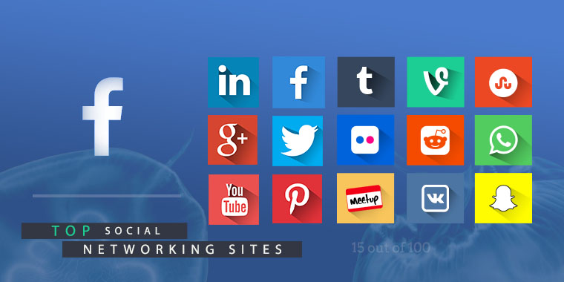
What is social netwok
Social network are a web-based service that focuses on building online communities of people who share interests and activities or who are interested in exploring the interest and activities of other.
Popular social networking sites
Facebook
Twitter
Youtube
Twitter
Google+ , etc

Slide 6
OBJECTIVE
Person can search for another user.
Person can make friends online across the world
Send and receive message within a second securely
A wall to comment and share information with privacy
Reach more people through another communication channel/groups
Connect friends online, where they can share their moments and message anyone instantly without any need to call each other
Suggest friends to a new user

Slide 7
Scope
used by friends to socialize
Live chat server for online user
People want a platform where they can interact/share information online
Privacy of user’s status among other person on network
User can ask questions on group

Slide 8
Requirement analysis
We take general idea of profile from “facebook”
When we unfriend a friends then our chat remains in database.
We do experiment on facebook status .we post a status on “facebook” and then share by multiple user. After deleting the original post we find out that all other shared status are deleted too.

Slide 9
Registration

Slide 10
User registration
User is asked to fill Name , username , emailid , password ,
Phone number , Dob , gender
Then user verify email id with that specific username provided at the time of registration
User
Friend’s book
Register at

Slide 11
Login in friend’s book
User provide the username and password for login .if the given data matches the database information
login is successful. ☺
Else enter detail again ☹
User
Friend’s book
login

Slide 12
ER Diagrams

Slide 13
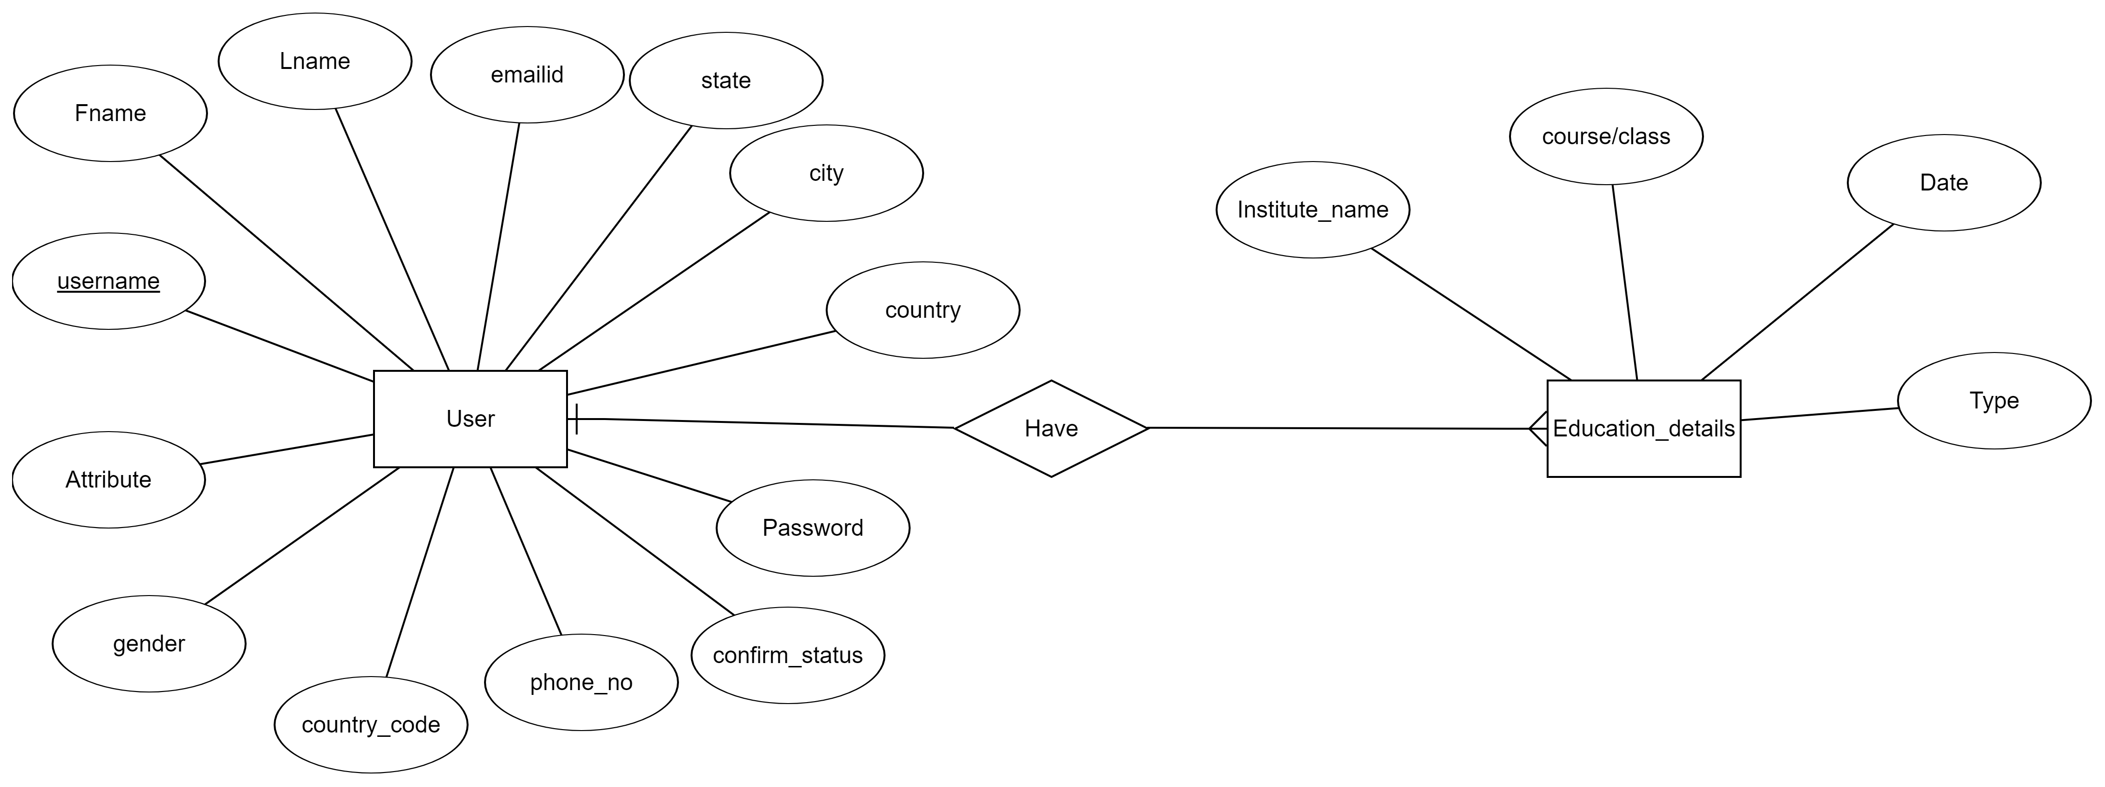
Search user

Slide 14
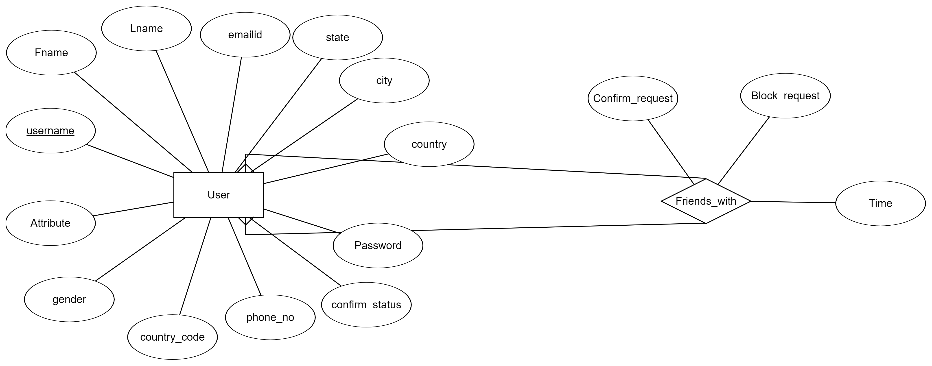
User Send /Receive friend request

Slide 15
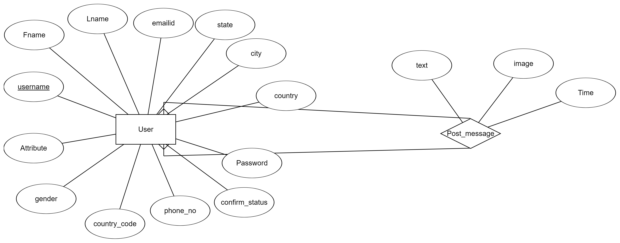
Send /Receive Message to friends

Slide 16
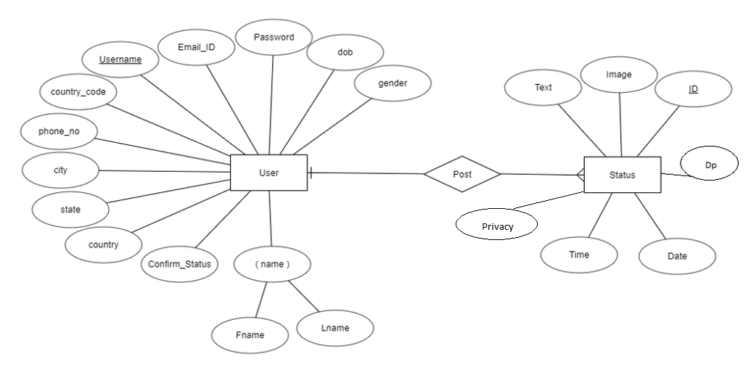
User post status

Slide 17
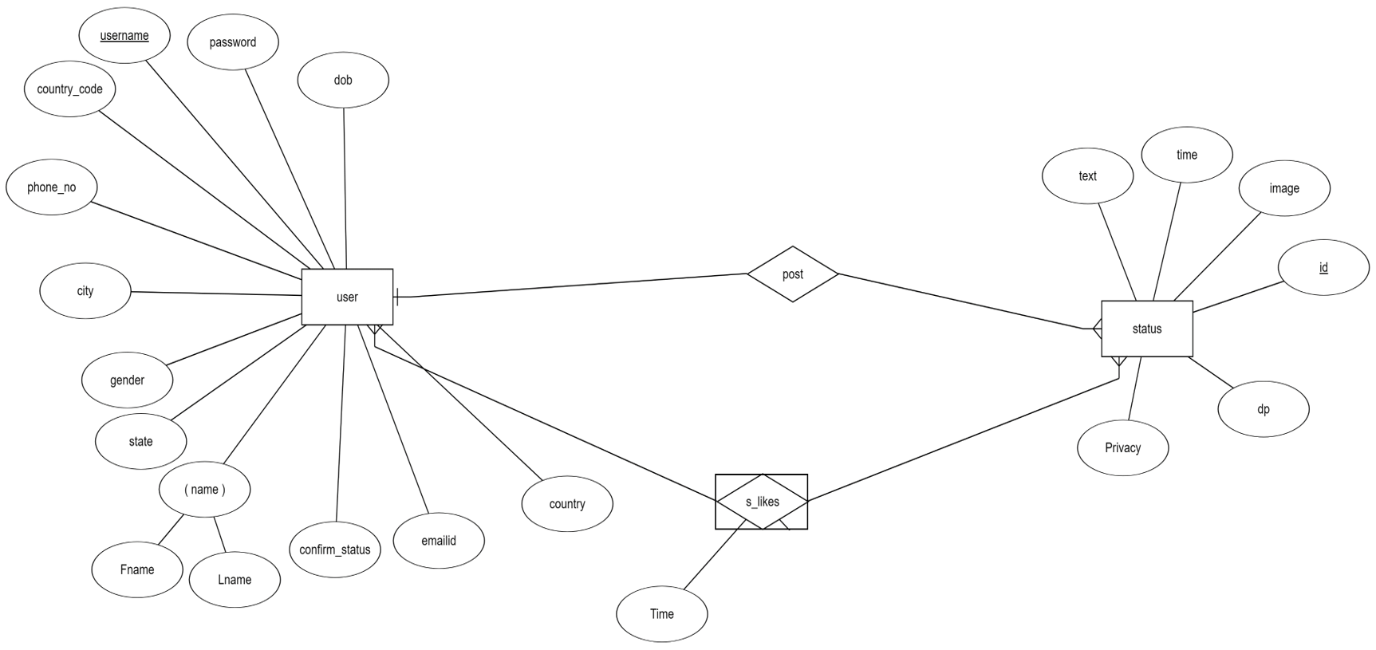
User likes on status

Slide 18
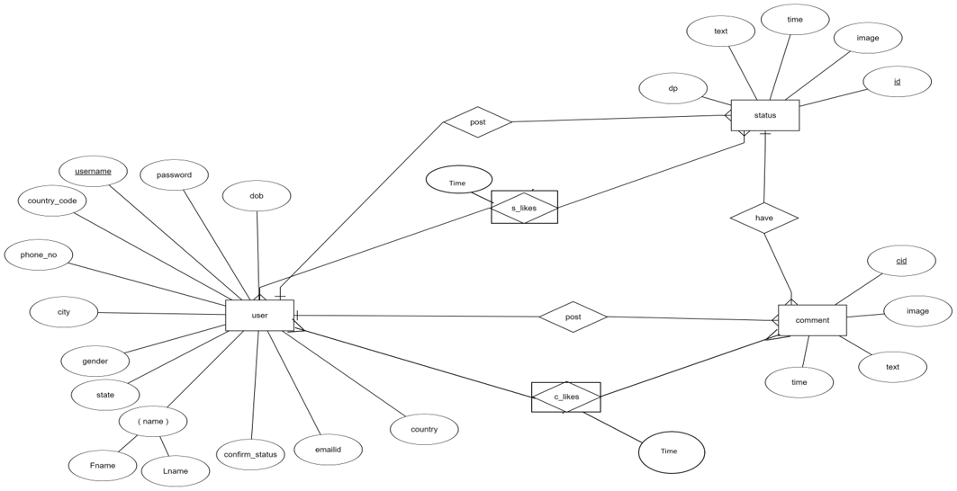
Comment and likes on status by user

Slide 19
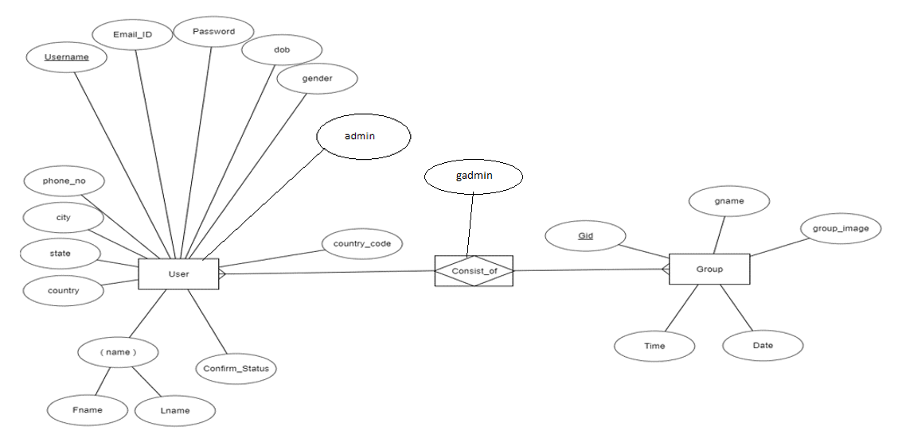
Group consist of user

Slide 20
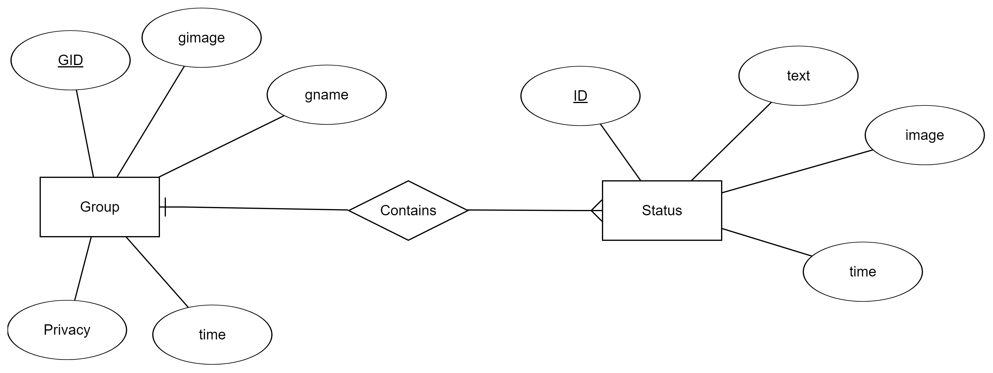
Group contains status

Slide 21
Previous ERD

Slide 22
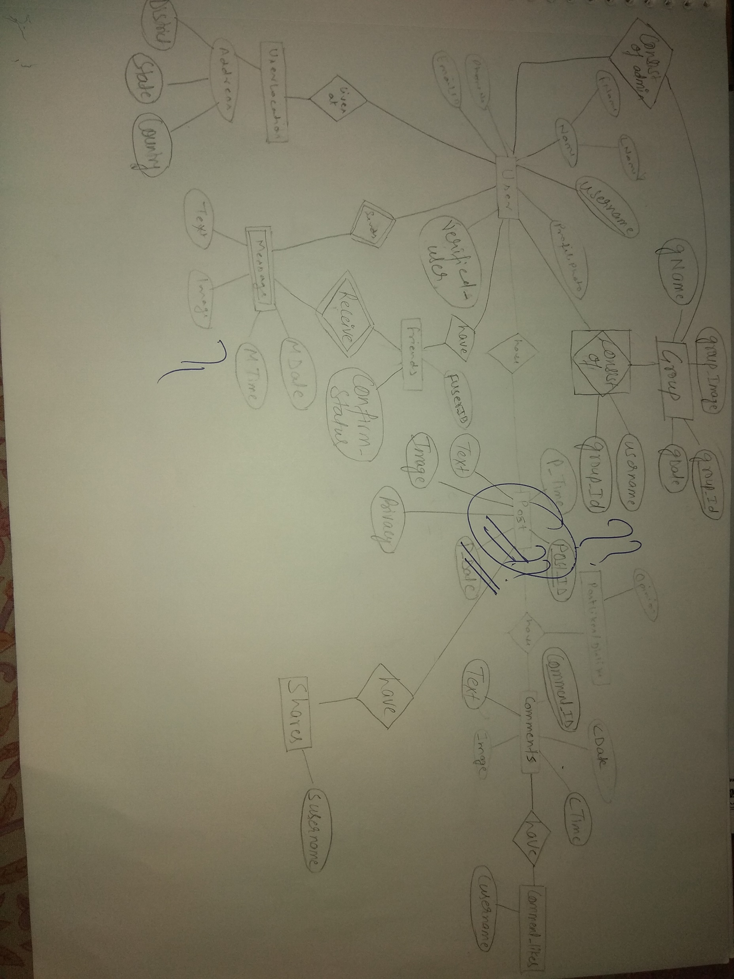

Slide 23
Problem in Previous ERD
Unable to find which user blocked which user.
We choose the wrong entity “post” instead of “status” which is a relationship.
We can store only limited education of a user. Like school,graduation and pg information(we created 1-1 relation).
User shared status wasn’t having any privacy details.
In “consist_of_admin” table there are some insertion anomalies.

Slide 24
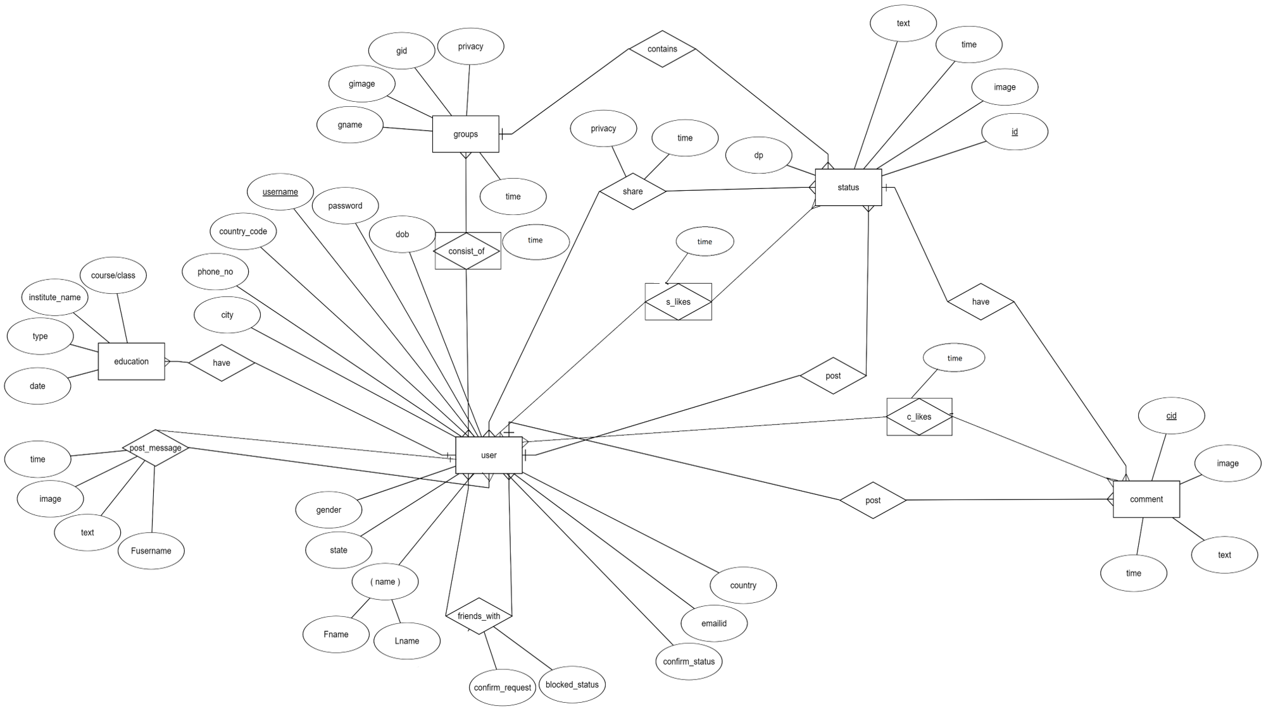

Slide 25
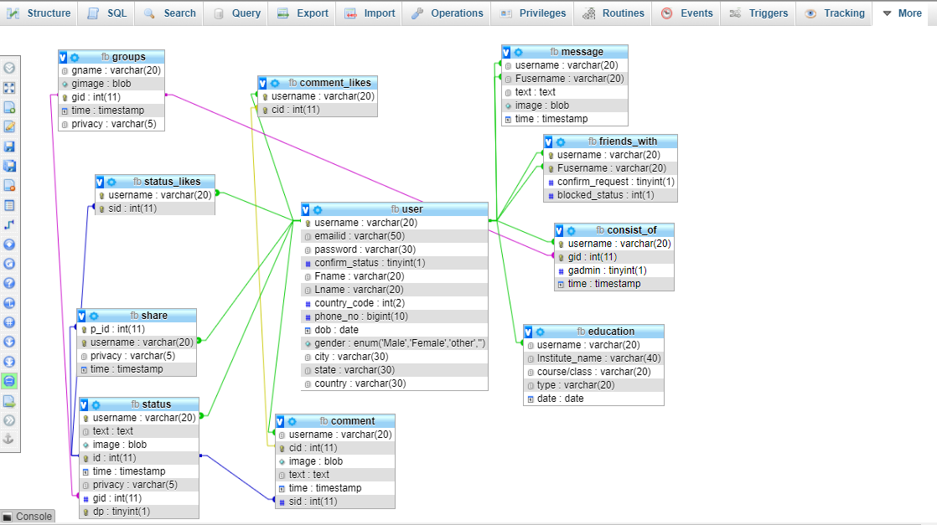

Slide 26
ERD USED IN PROJECT

Slide 27
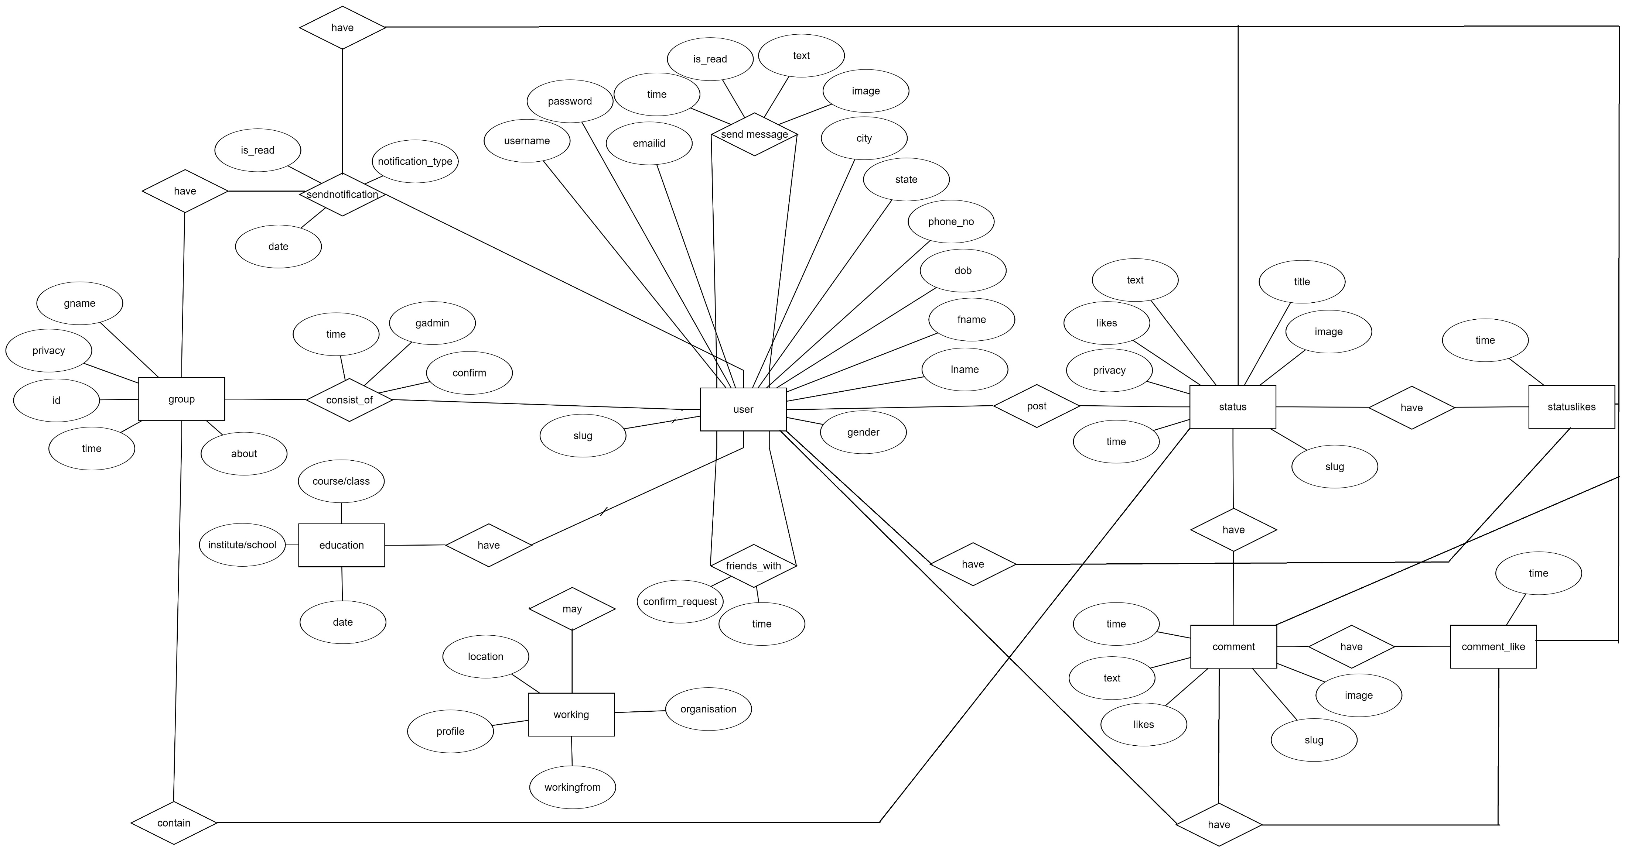

Slide 28
List of Database Tables

Slide 29
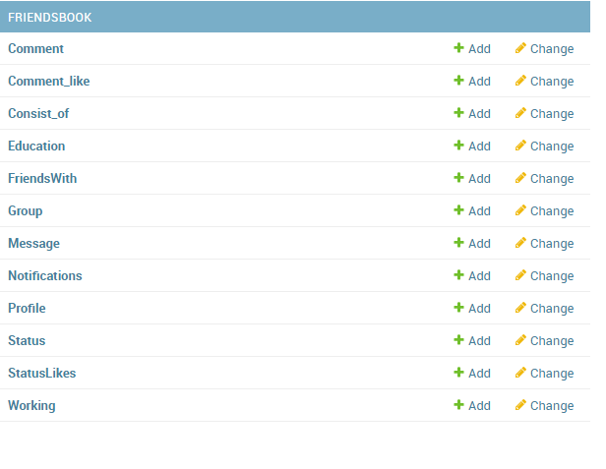

Slide 30
Django A Python MVC FRAMEWORK

Slide 31
Django Architecture

Slide 32
Models(Database tables) In Django

Slide 33
How to create Models

Slide 34
Django ORM(Object Relational Mapping) Queries

Slide 35
Objective:Find Information about username ‘nishu’ Obj=Profile.objects.get(username=User.objects.get(‘nishu’))
Print Content of object:
Print(obj.username)
Print(obj.fname)
Result:
root
Nishant

Slide 36
Friend List Query
def FindFriends(request,user): obj1=FriendsWith.objects.filter(username=user,confirm_request=2,blocked_status=0).select_related('fusername').values('fusername’)
obj1=User.objects.filter(id__in=obj1)
obj2=FriendsWith.objects.filter(fusername=user,confirm_request=2,blocked_status=0).select_related('username').values('username') obj2=User.objects.filter(id__in=obj2) obj=obj1 | obj2 chatusers=obj
Return Result:
<QuerySet [<User: abhistin>, <User: nishu>, <User: sachin>, <User: dhisu>]>

Slide 37
Friends Suggestions
def FriendsOfFriends(request,user):
chatusers= FindFriends(request,User.objects.get(username=user))
friends_suggestion=User.objects.none()
for x in chatusers:
y= FindFriends(request,x)
friends_suggestion= friends_suggestion | y
user=User.objects.filter(username=user)
chatusers=user|chatusers
friends_suggestion=friends_suggestion|chatusers
return friends_suggestion

Slide 39
WEBSITE

Slide 40
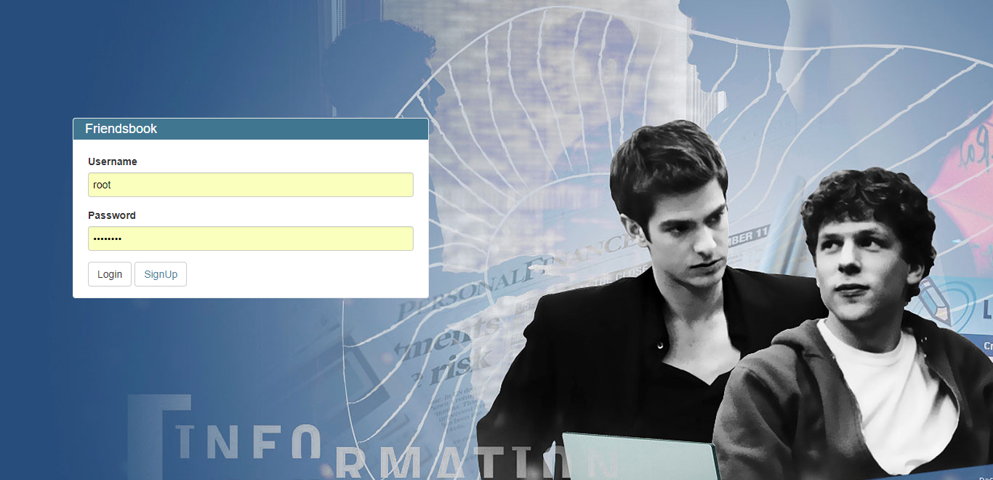

Slide 41
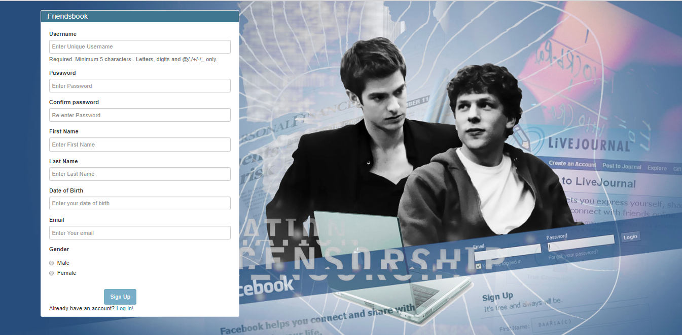

Slide 42
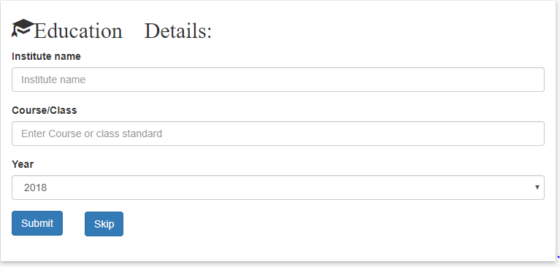

Slide 43
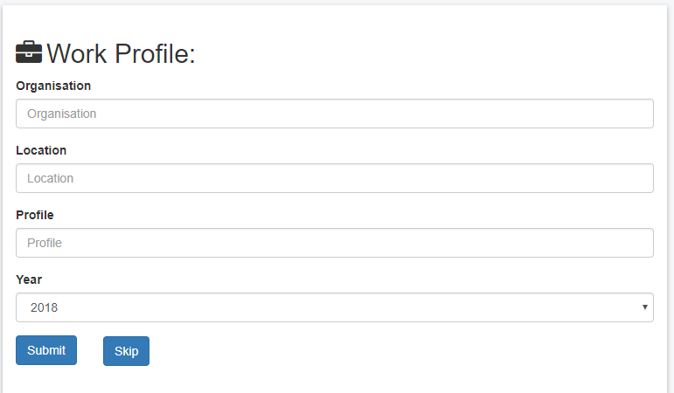

Slide 44
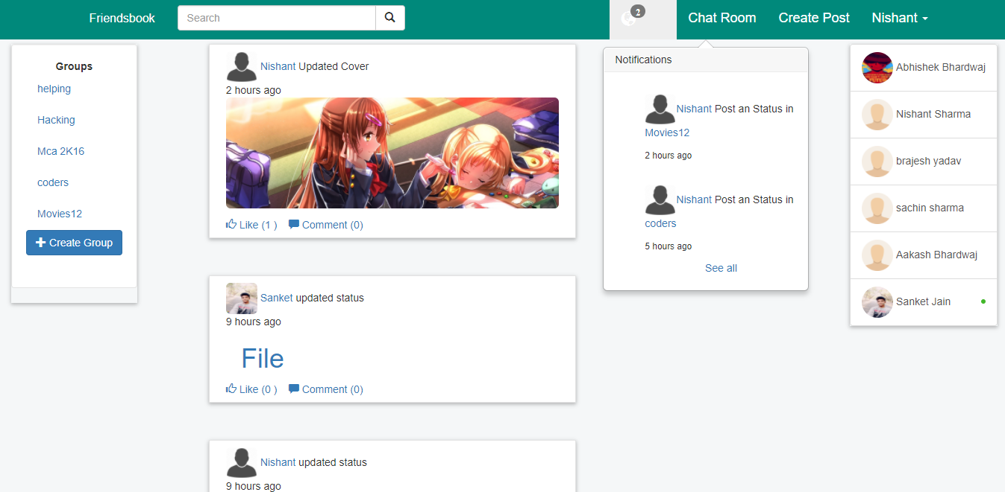

Slide 45
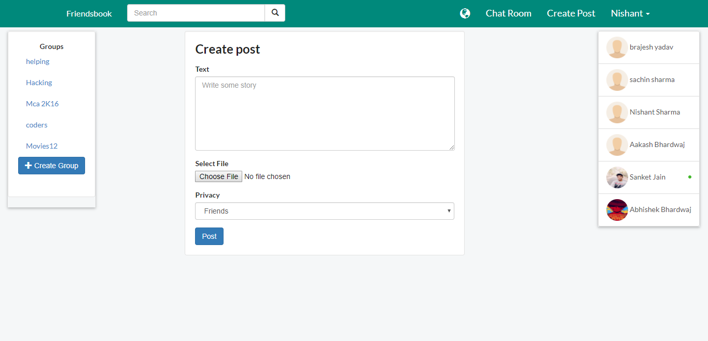

Slide 46
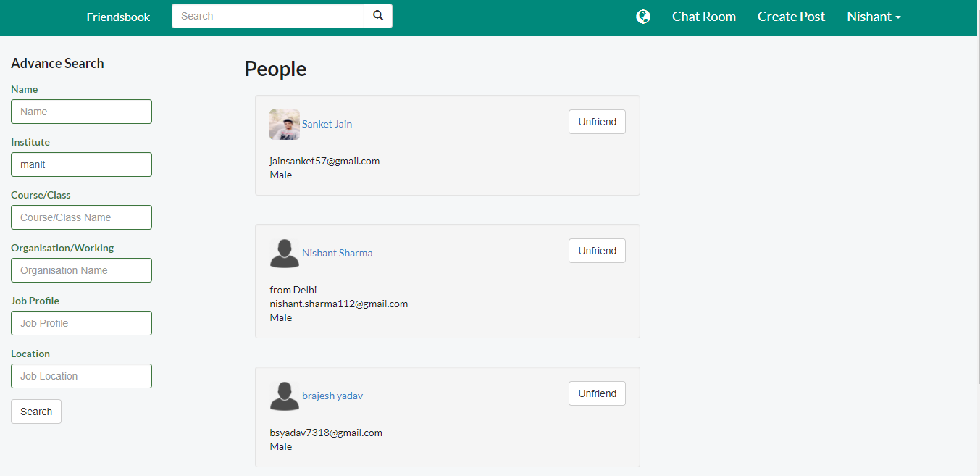

Slide 47
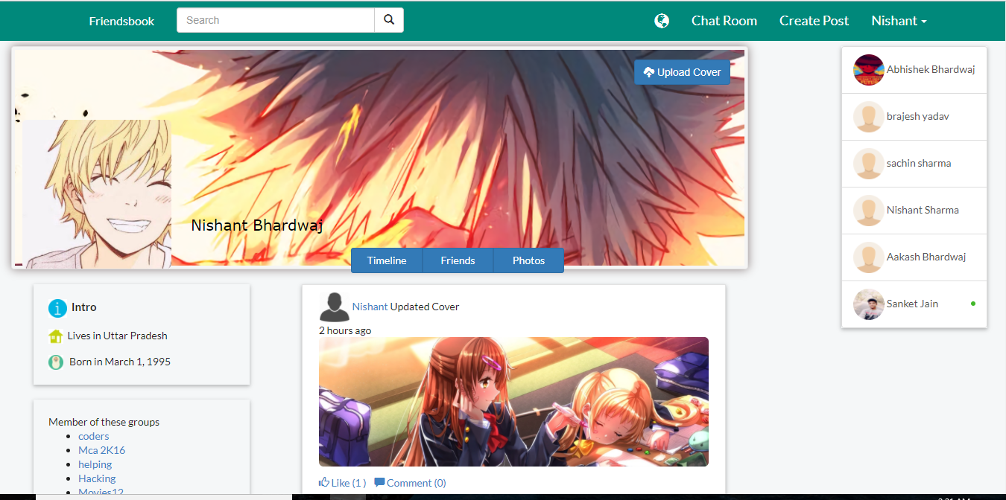

Slide 48
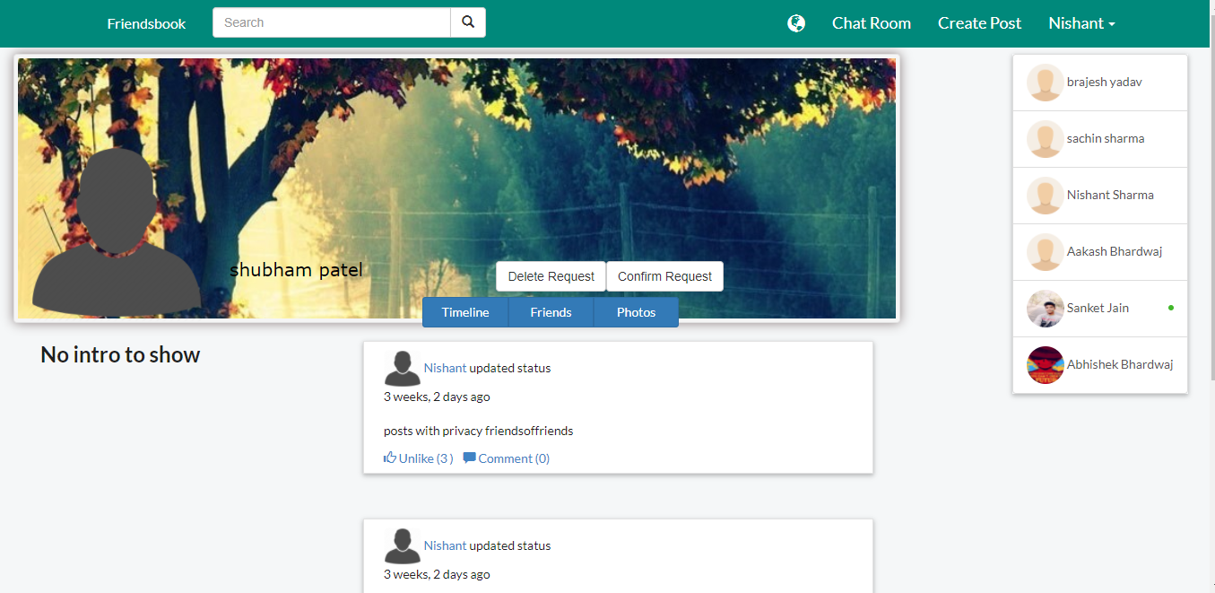

Slide 49
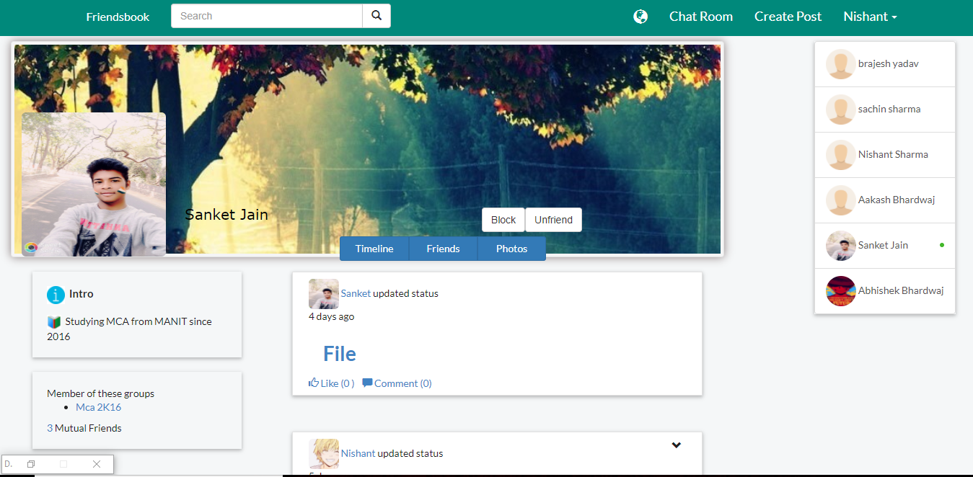

Slide 50
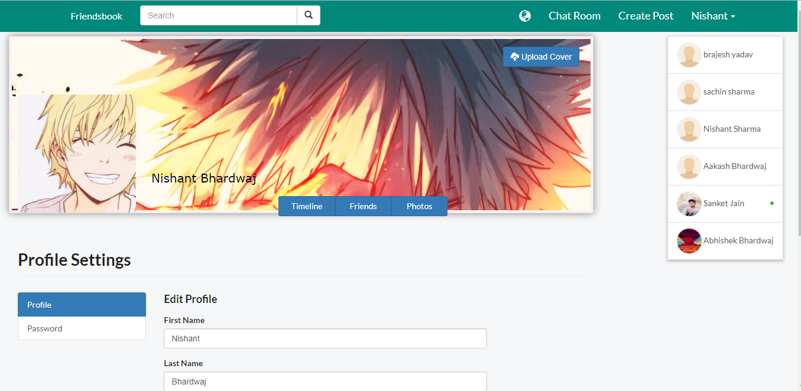

Slide 51
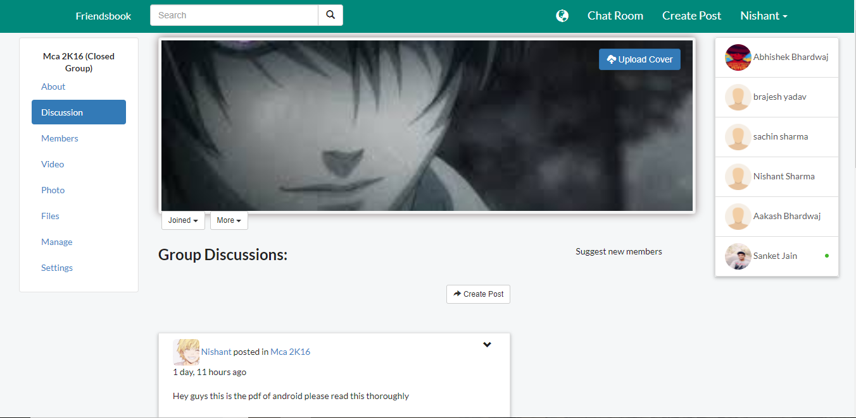

Slide 52
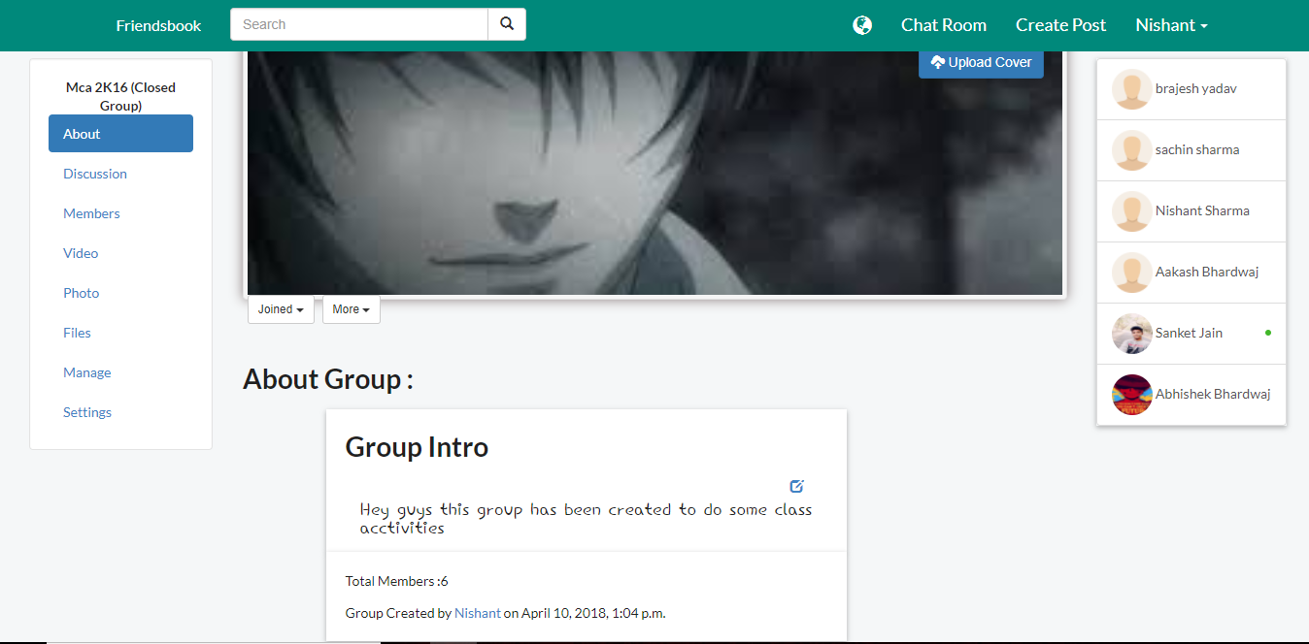

Slide 53
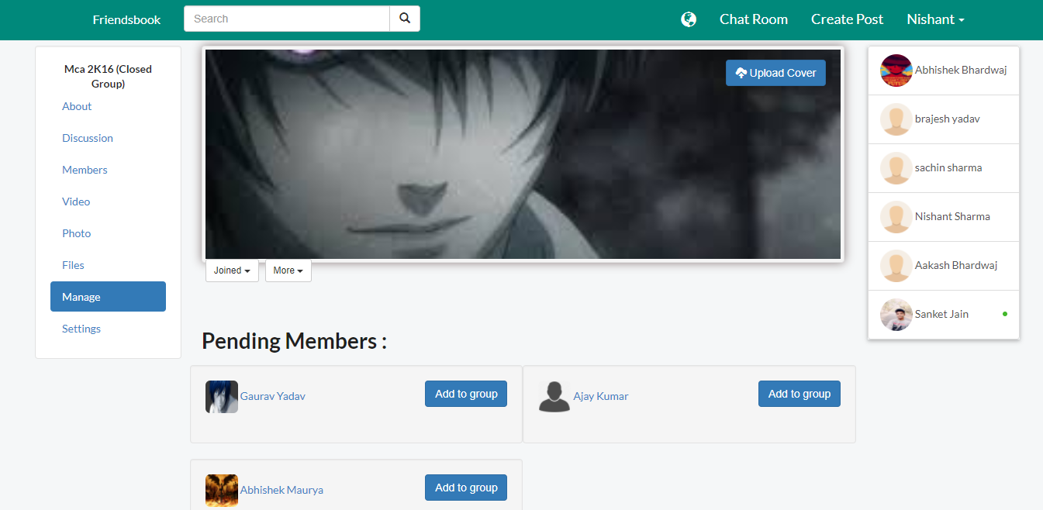

Slide 54
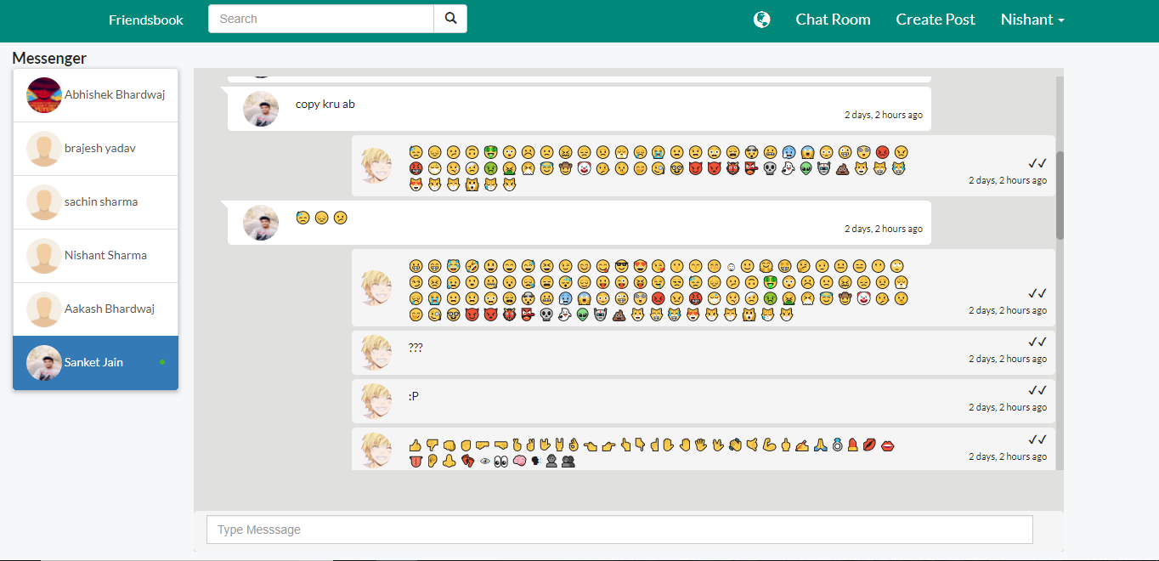

Slide 55
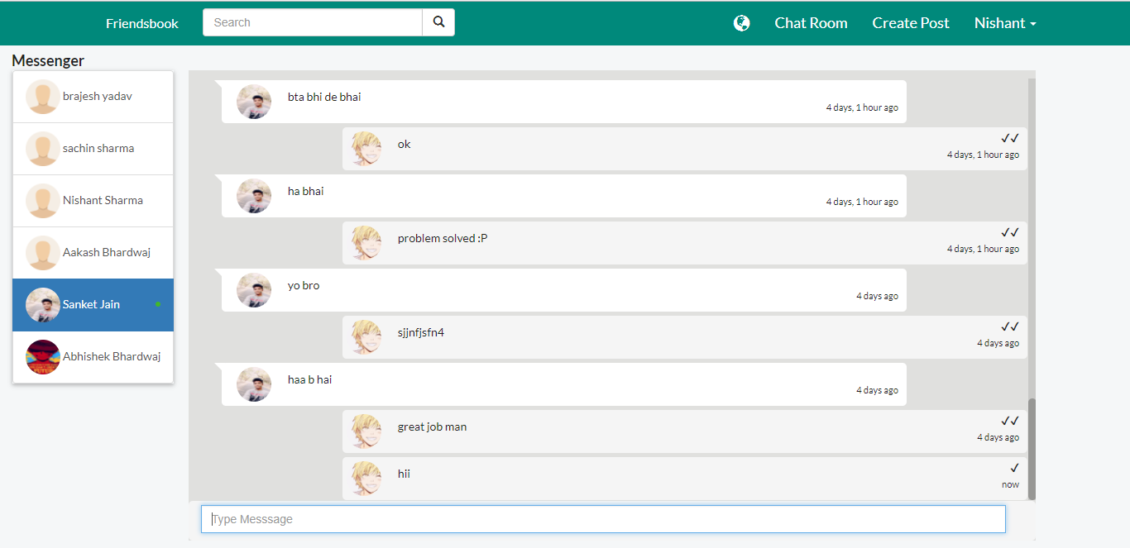

Slide 56
BIBLIOGRAPHY
Since Django is a open source framework.There were not so tutorial(Video lectures) available for us to learn more about that.But some of the sources are very good like these..
https://simpleisbetterthancomplex.com/
This blog belongs to Vitor Freitas. He is a passionate software developer and researcher from Brazil.He did a project on bootcamp(django based) .We take some general idea about implementation of dajngo from his project(which is available in github: https://github.com/vitorfs/bootcamp)

Slide 57
Djnago documentation Was also a very good help.It helped us to check a lot of syntax and how we use a lot of Django inbuilt functions.
https://docs.djangoproject.com/en/2.0/
At the time We use Dajngo the latest version was dajngo 2.0 .
There are lots of package which doesn’t support that version.Due to which we were not able to use “emoji’s “ in our chat applications
And When we not find our answer at any site we took help of https://stackoverflow.com/.
We asked a lot of questions on that and lot of questions were answered by Daniel Roseman.
My stackoverflow profile:-
https://stackoverflow.com/users/7291681/nishant-sharma

Slide 58
Project Hosted On Heroku:
https://thefriendsbook.herokuapp.com/
Github repo of project:
https://github.com/nishu112/friendsbook
Project ppt is also available in repository:
https://github.com/nishu112/currentwork

Slide 59
Thank You!.

